Slide 1
TutorLink
- Dylan Soto - Terrance Lee

Slide 2
WHAT IS TUTOR-LINK?
Tutor Link is a web app that helps college students find and schedule tutoring with other students.
• Students search for help by subject
• Tutors manage their schedule, subjects, and rates
• Built-in messaging keeps everything in one place

Slide 3
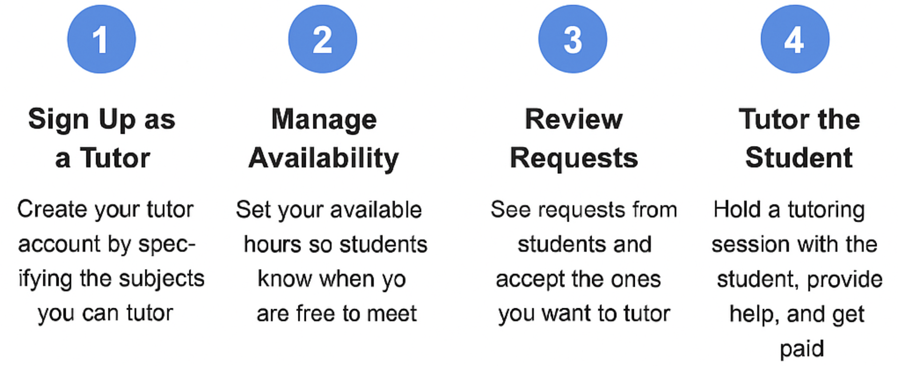
For Tutors
-Onboarding steps-
Sign Up: Create a tutor account and choose your subjects.
Set Availability: Let students know when you’re free to tutor.
Review Requests: Accept session requests from interested students.
Start Tutoring: Meet, teach, and earn for each session.

Slide 4
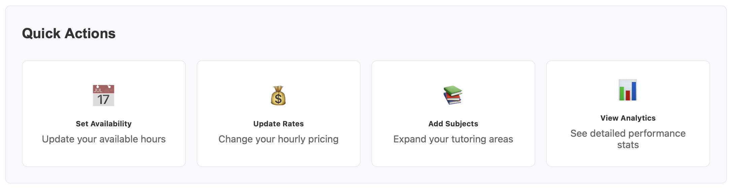
Tutor Functionality
Set Availability: Manage your tutoring schedule so students know when you’re available to meet.
Update Rates: Adjust your hourly pricing to reflect your experience, demand, or subject area.
Add Subjects: Expand your tutoring profile by listing additional subjects you can teach.
View Analytics: Track performance stats like earnings, ratings, and session history to grow your impact

Slide 5
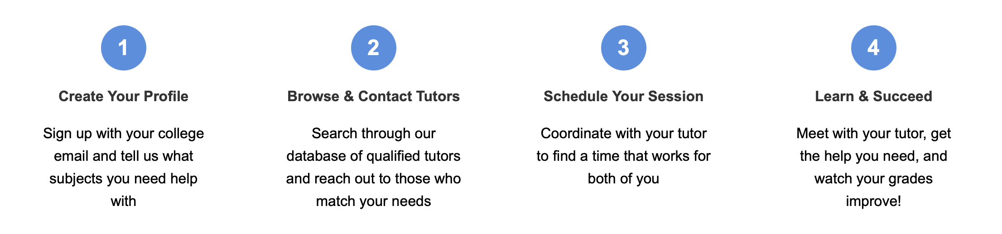
For Students
-Onboarding steps-
Create Your Profile: Sign up using your college email and select subjects you need help with.
Find a Tutor: Browse qualified tutors based on subject, rating, and availability.
Schedule a Session: Coordinate with your tutor to find a time that works for both of you.
Get Help & Improve: Meet with your tutor, strengthen your skills, and boost your grades.

Slide 6
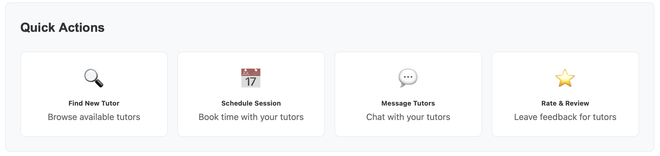
Student Functionality
• Find a Tutor: Browse and filter tutors by subject, rating, and availability.
• Schedule Sessions: Book tutoring sessions that fit your schedule and learning goals.
• Message Tutors: Chat directly with your tutors to ask questions or coordinate plans.
• Rate & Review: Leave feedback to help other students and recognize great tutors.

